Slide 1
INCREASED FIRE RESISTANCE OF A STEEL BEAM USING ORIENTED STANDARD BOARD CLADDING – A THERMAL ANALYSIS
https://firesafetyengineering.net/
Jakub Šejna

Slide 2
Outline
Motivation
Introduction
Experiments
FE model
Summary

Slide 3
Unprotected steel member
Clading
Protected steel member
Motivation
Introduction
Experiments
FE model
Summary
Sustainability of structures - in case of fire
Reduction of CO₂ emissions
Reduction of primary energy
Primary energy
Wood : Cement = 1 : 3
Wood : Steel = 1 : 27
Wood : Aluminium = 1 : 70
wood-based cladding materials

Slide 4
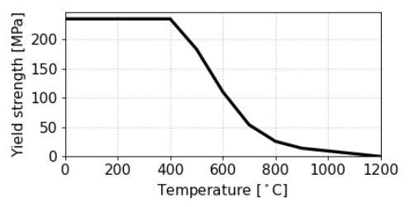
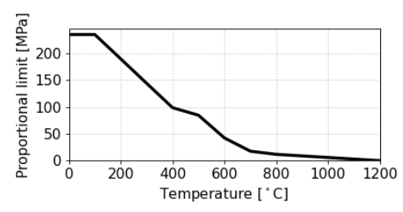
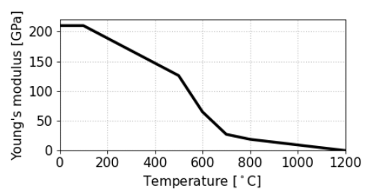
STEEL EN 1993-1-2
Unprotected steel element
OSB cladding
Protected steel element
?
ok
Motivation
Introduction
Experiments
FE model
Summary
Design steel elements to their critical temperature
OK
What if the critical temperature is higher than 600 °C?
What if the design is badly dimensioned?
What If the steel temperatures are higher?
?
ok
?
ok

Slide 5
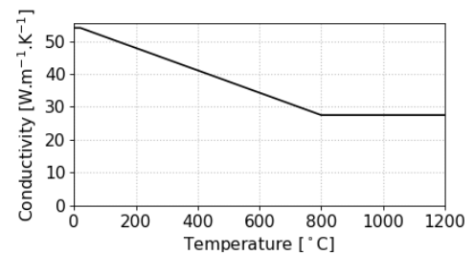
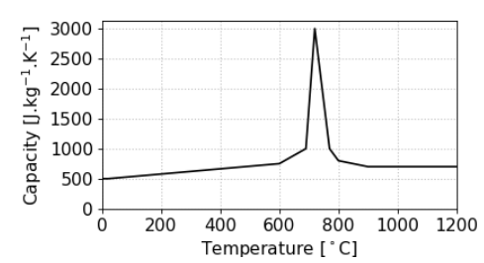
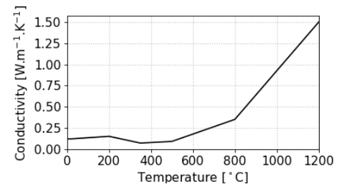
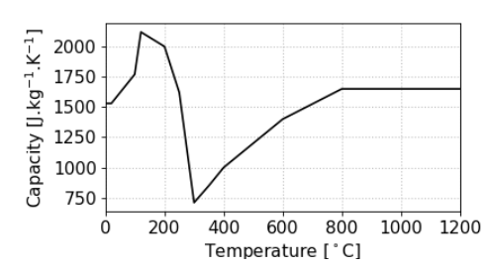
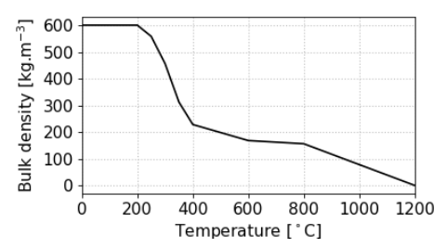
STEEL
TIMBER
Introduction
Introduction
Experiments
FE model
Summary
Comparison of procedures for additional fire protection proposals
Effect on mechanical analysis
EN 1993-1-2
EN 1995-1-2
Comparison
Experiment
+ FEM model

Slide 6
doi: 10.3390/ma12234003
doi: 10.1007/978-3-030-41235-7_58
doi:10.1002/cepa.1423
doi:10.1007/978-3-030-41235-7_58
doi: 10.14311/APP.2022.34.0116
1974 Twild and Witteveen
2019 Le
2020 Béreyziat
2021 Bihina
2021 Šalek
2022 Šejna and Šulc
35 mm softwood clading
Timber–Steel Composites
I or T steel profile
Timber encasement of steel structures
Numerical modelling
Mechanical analysis
+ 60 min of fire resistence of steel member
Steel and mass timber
complete or partial fire protection by timber
alternative fire insulation
OSB cladding of wall
OSB cladding of steel beam
Introduction
Introduction
Experiments
FE model
Summary
Safe design:
Pyrolysis of OSB
Development of char layer
Failure of cladding
Model of OSB burning as a fire protection material

Slide 7
doi: 10.3390/ma12234003
doi: 10.1007/978-3-030-41235-7_58
doi:10.1002/cepa.1423
doi:10.1007/978-3-030-41235-7_58
doi: 10.14311/APP.2022.34.0116
1974 Twild and Witteveen
2019 Le
2020 Béreyziat
2021 Bihina
2021 Šalek
2022 Šejna and Šulc
35 mm softwood clading
Timber–Steel Composites
I or T steel profile
Timber encasement of steel structures
Numerical modelling
Mechanical analysis
+ 60 min of fire resistence of steel member
Steel and mass timber
complete or partial fire protection by timber
alternative fire insulation
OSB cladding of wall
OSB cladding of steel beam
Introduction
Introduction
Experiments
FE model
Summary
Safe design:
Pyrolysis of OSB
Development of char layer
Failure of cladding
Model of OSB burning as a fire protection material

Slide 8
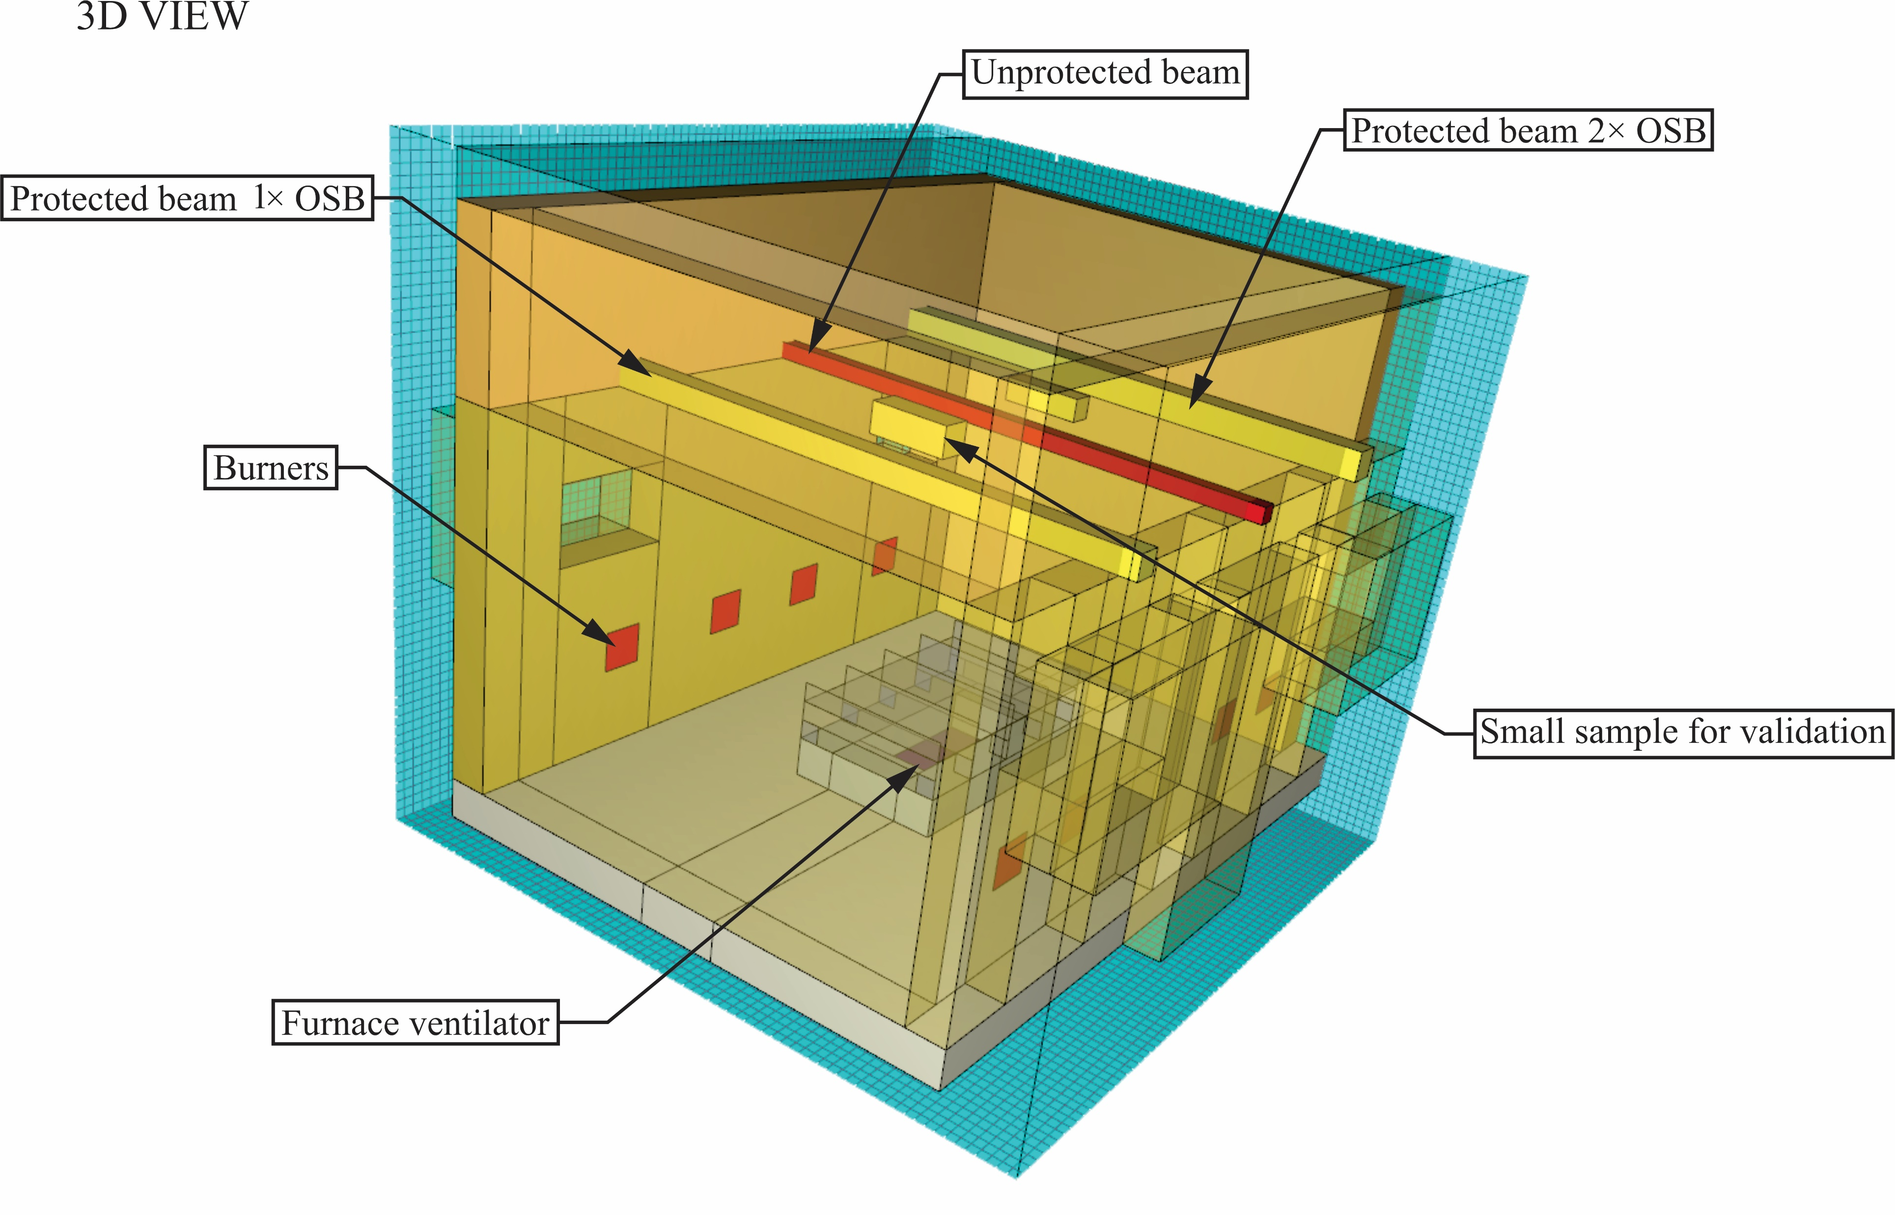
Location of elements based on the parametric study
Introduction
Experiments
FE model
Summary
Experiment
Horizontal furnace
5 samples
Unprotected beam, Length = 3.7 m, loaded
1x OSB protected beam, Length = 3.7 m, loaded
2x OSB protected beam, Length = 3.7 m, loaded
1x OSB protected beam, Length = 0.5 m, unloaded
2x OSB protected beam, Length = 0.5 m, unloaded

Slide 9
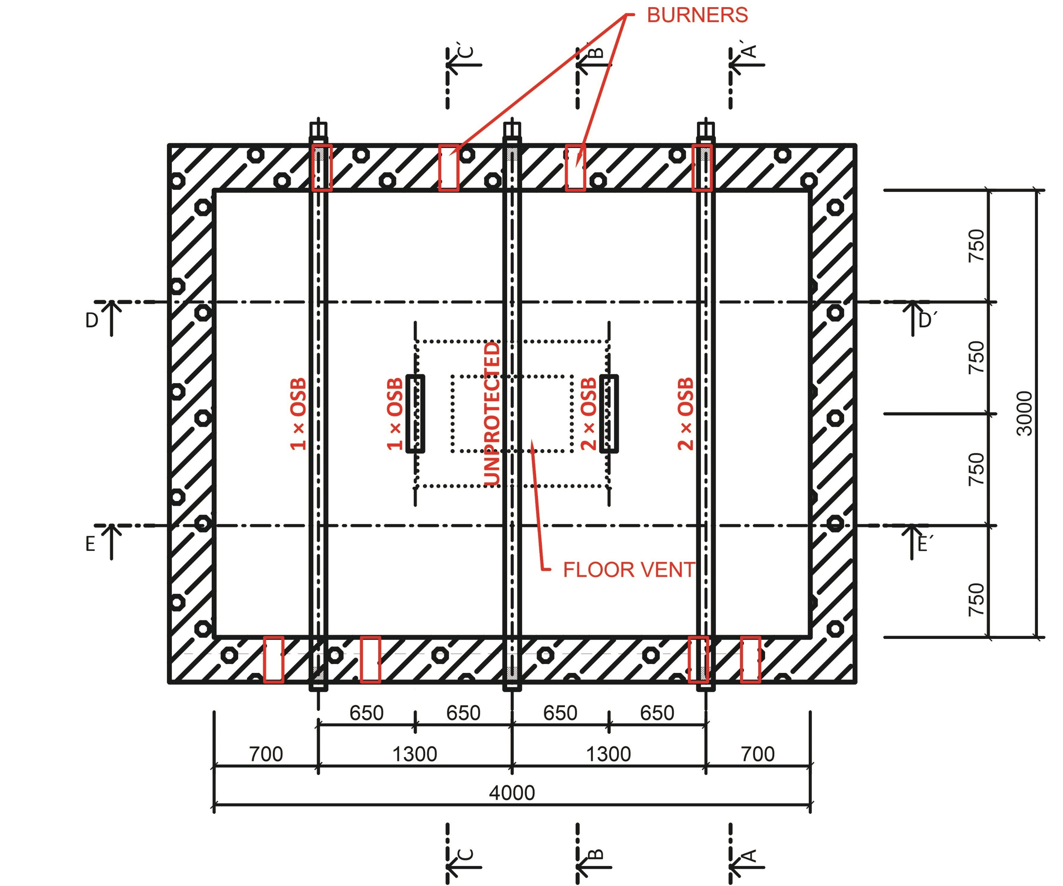
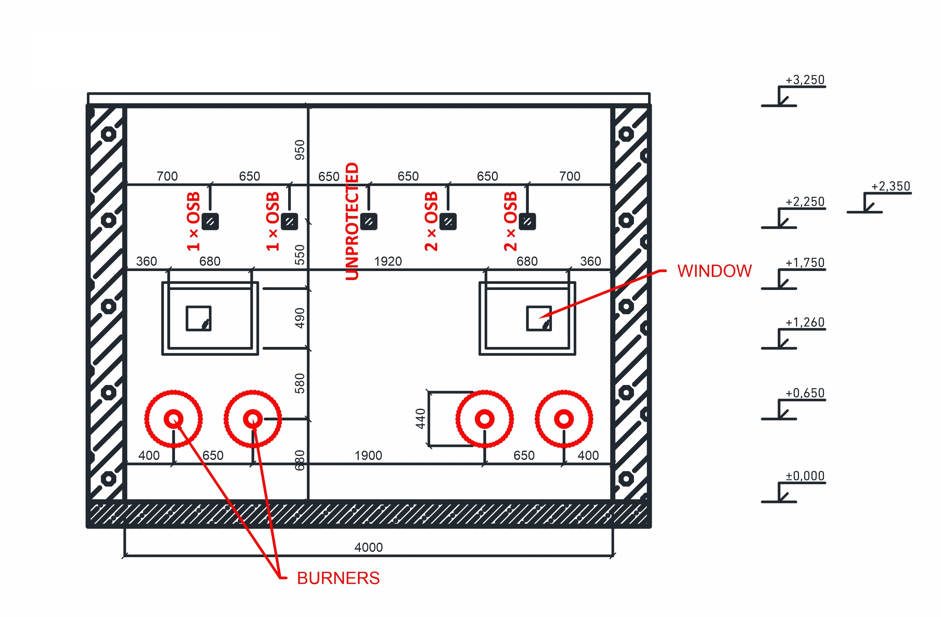
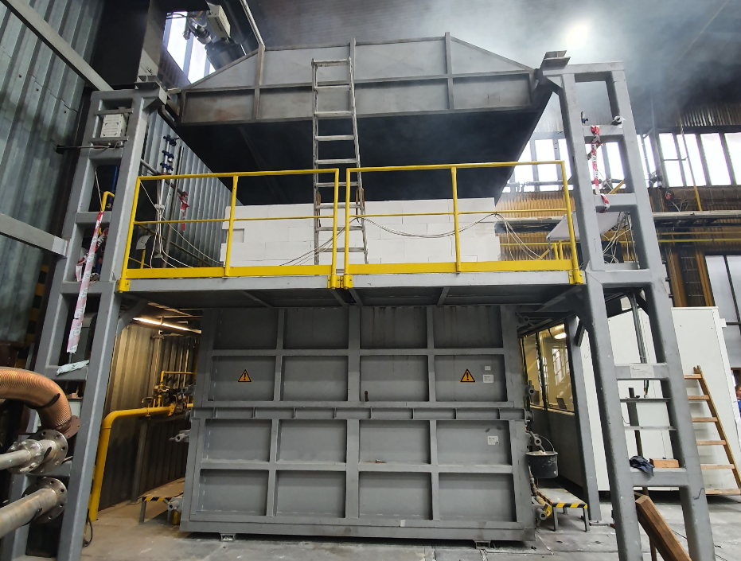
Introduction
Experiments
FE model
Summary
Horizontal furnace
Samples
Dimension 4.0 × 3.0 × 3.25 m
Experiment = 60 min
Temperature: Standard Temperature Curve
Ventilation = Automatic preasure 18 – 20 MPa
1x OSB = 1 × 22 mm OSB
2x OSB = 2 × 22 mm OSB
Thermocouples conducted in mineral insulation in the beam
Steel profile: SHS 100/6
Thermocouples: Under clading – on steel surface
MTC12 /1xK T2 /N4m /GHGH 2x0,5 / K-MM + MTC10 /1xK T2 /P1,5 /N3000 /K-MM
note: earlier experiments on the small scale

Slide 10
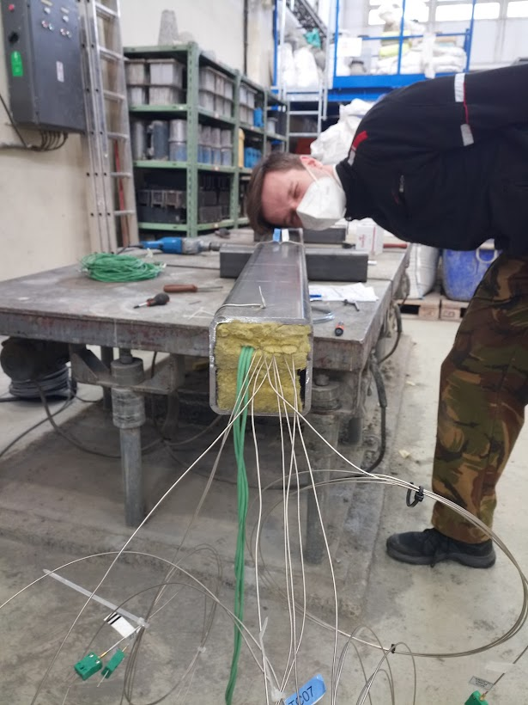
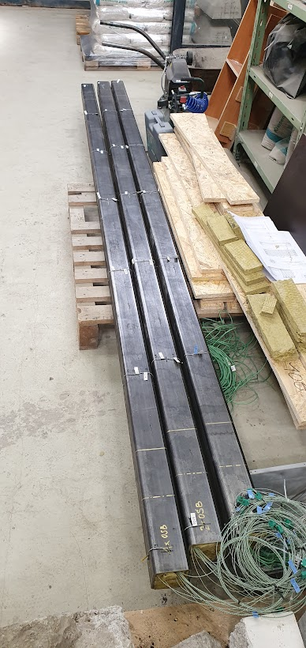
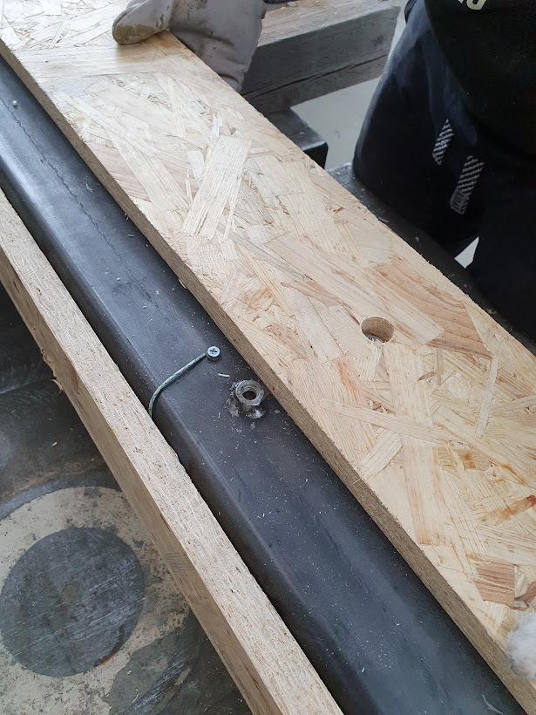
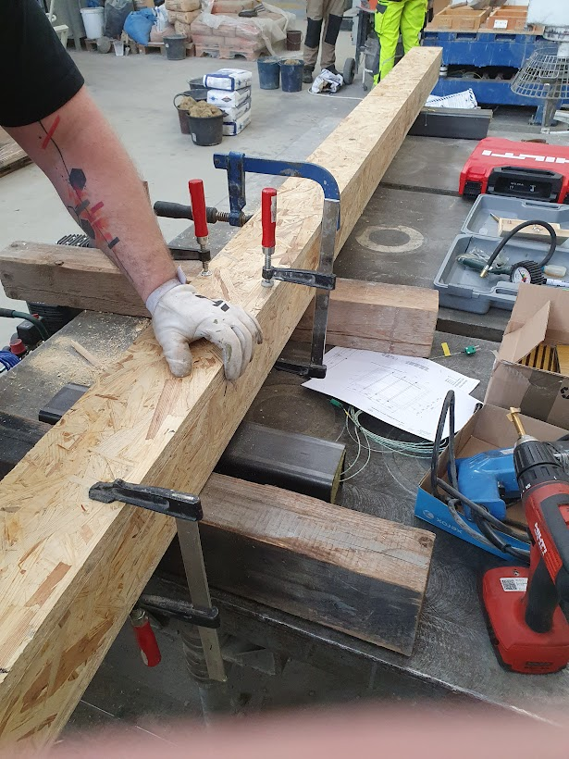
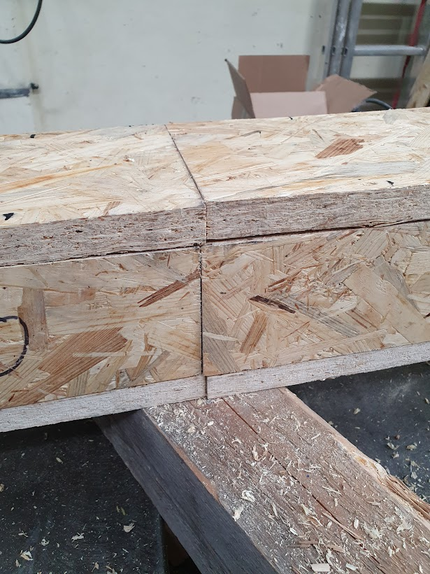
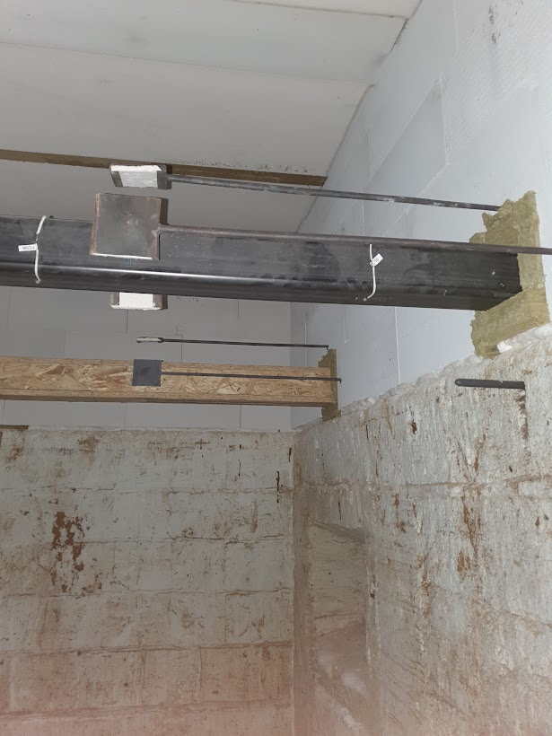
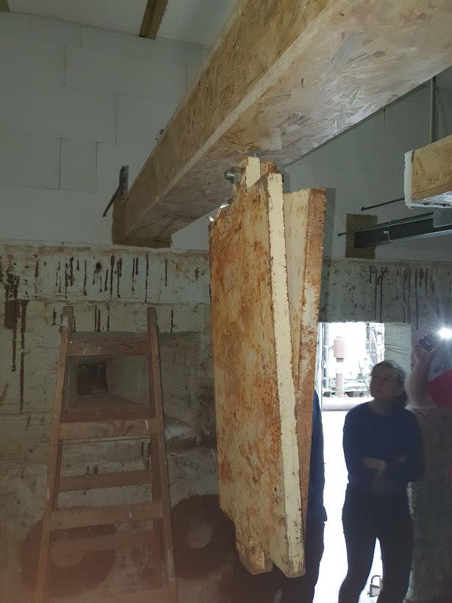
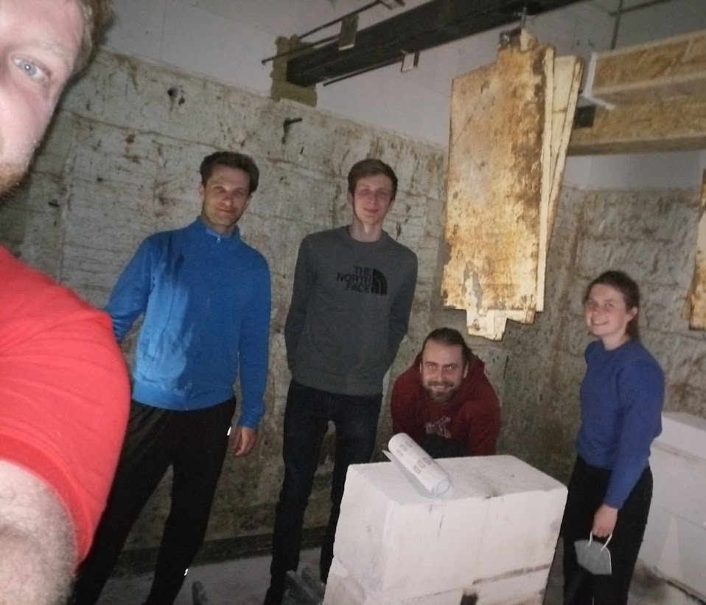
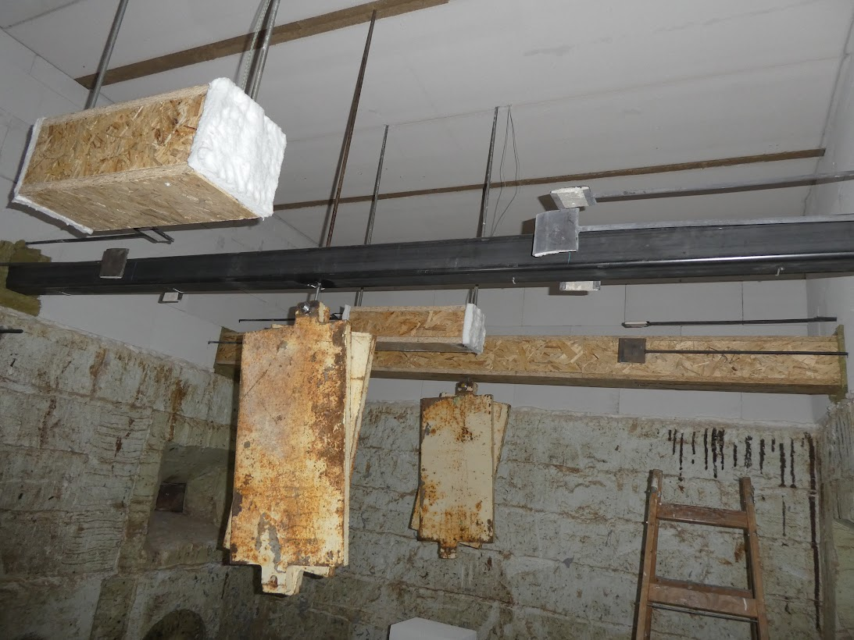
1
2
3
4
5
6
7
8

Slide 11
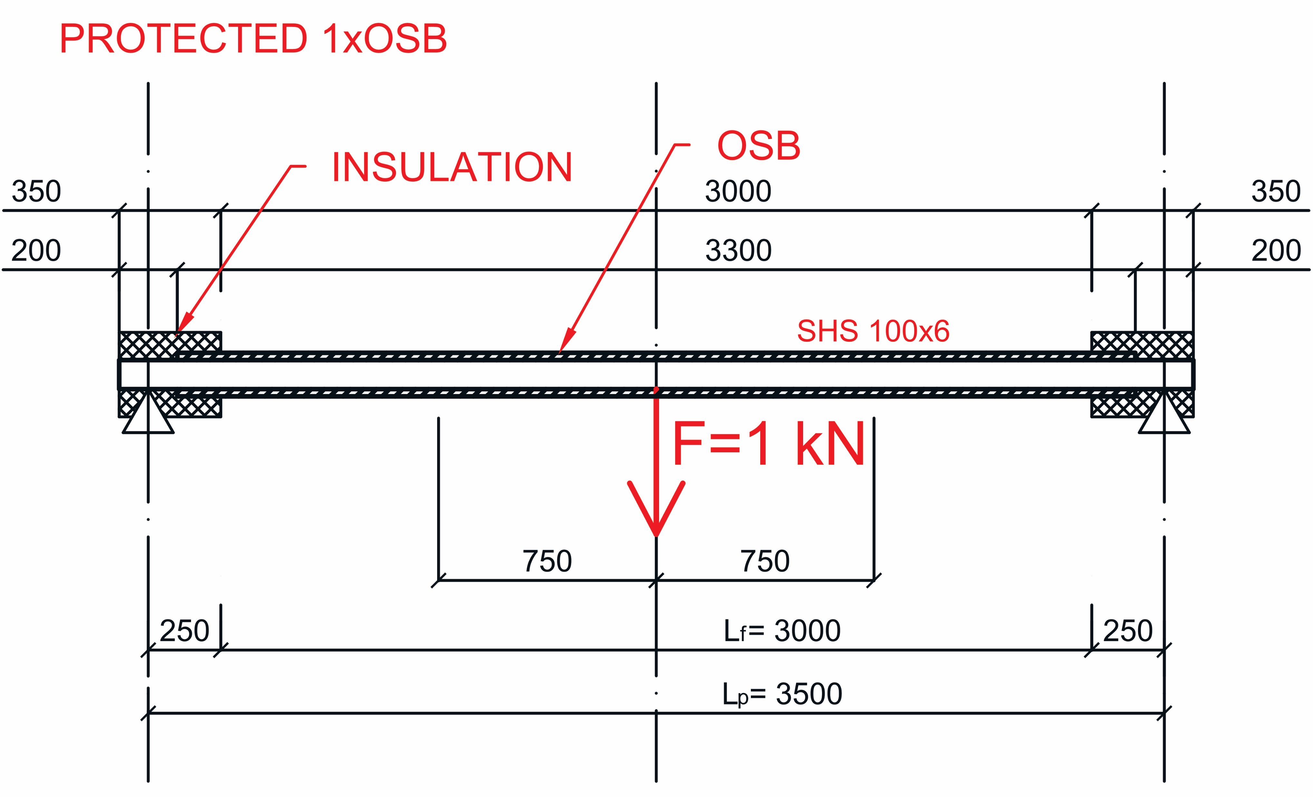
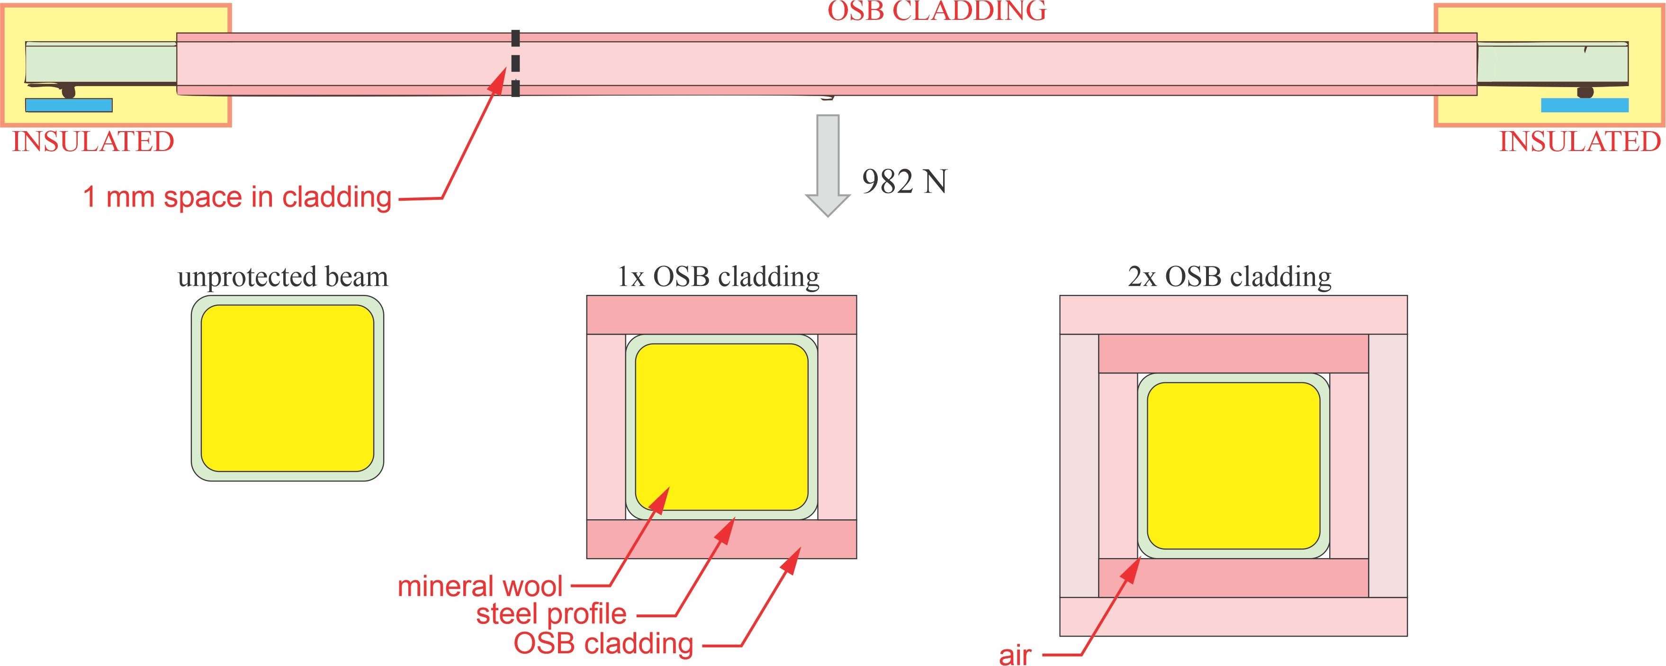
Introduction
Experiments
FE model
Summary
Experiment
1× OSB 22 mm
Load 0.982 kN
+ OSB 22mm → burn-off / fall-off in 20 min
60 min of experiment
temperature of steel = 868 °C maximum deflection unprotected beam no damage to the furnace

Slide 12
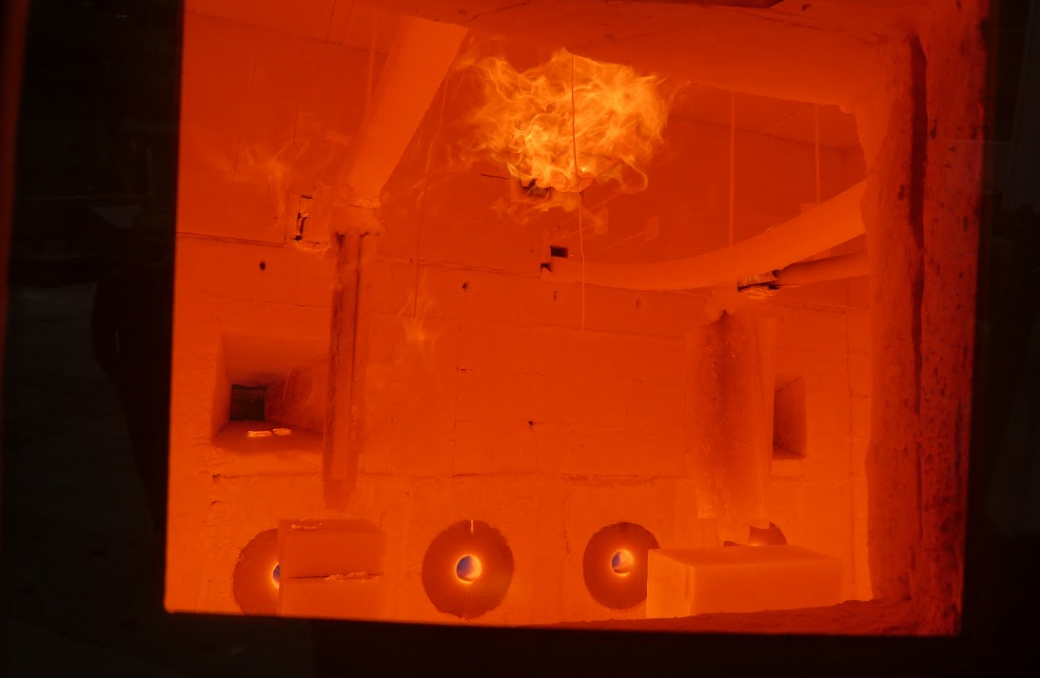
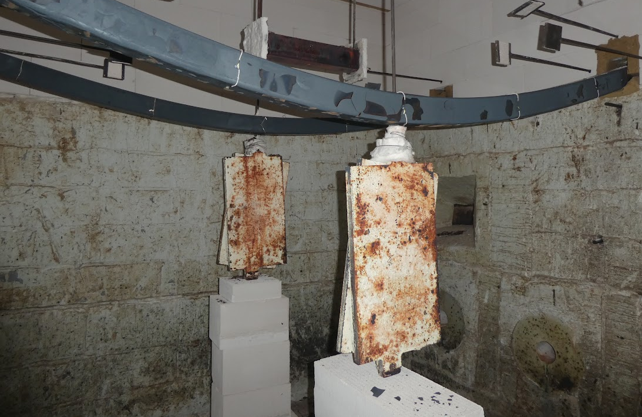
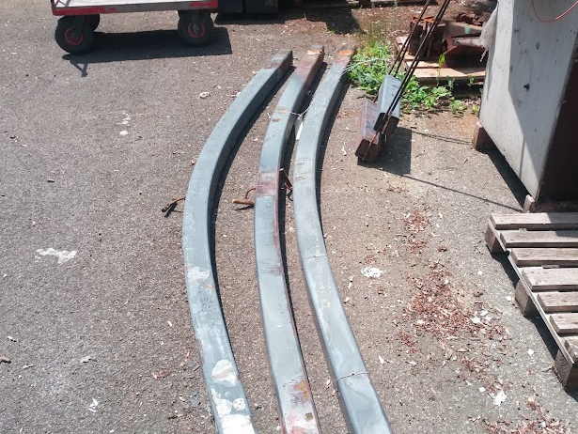
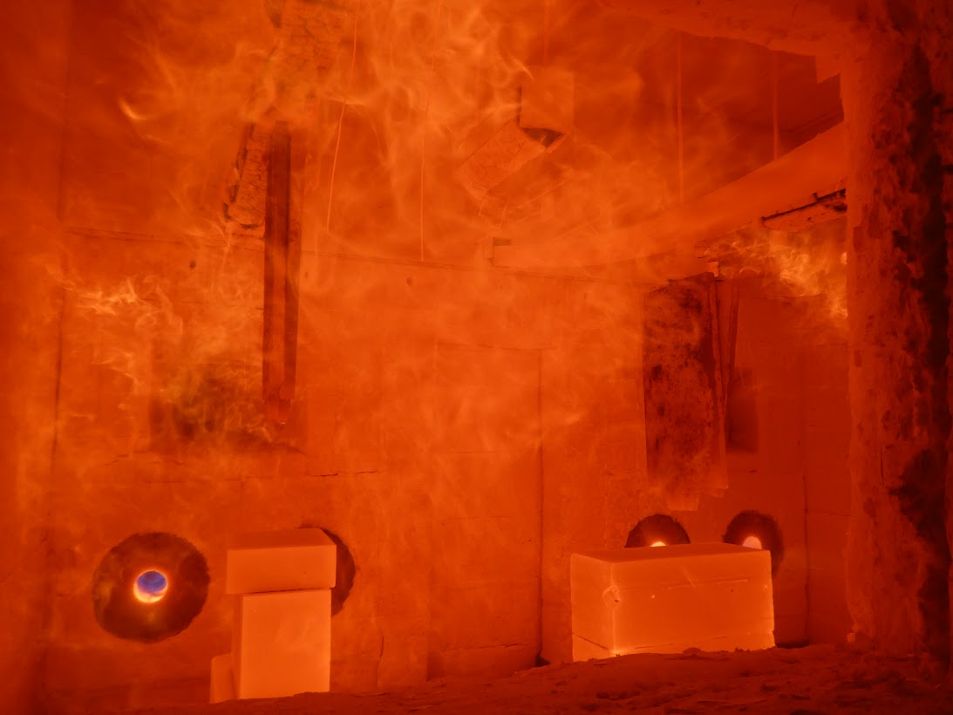
1
2
6
3
5

Slide 13
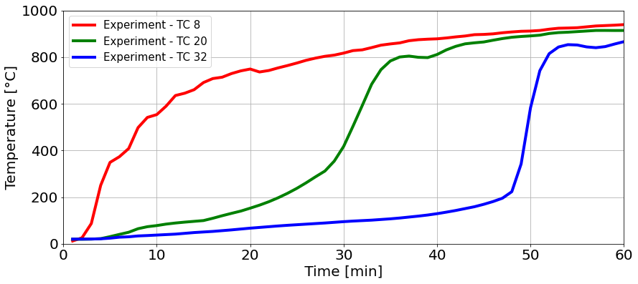
Experiment
Introduction
Experiments
FE model
Summary
TC placed under the OSB cladding on the surface of steel
Temperatures
Time [min] | Temperature in furnace [°C] | Unprotected beam (reference) [°C] | 1× OSB 22 mm protected beam TC 18 [°C]
15 | 747 | 632 | 94
30 | 848 | 816 | 371
45 | 902 | 921 | 860
60 | 948 | 940 | 868

Slide 14
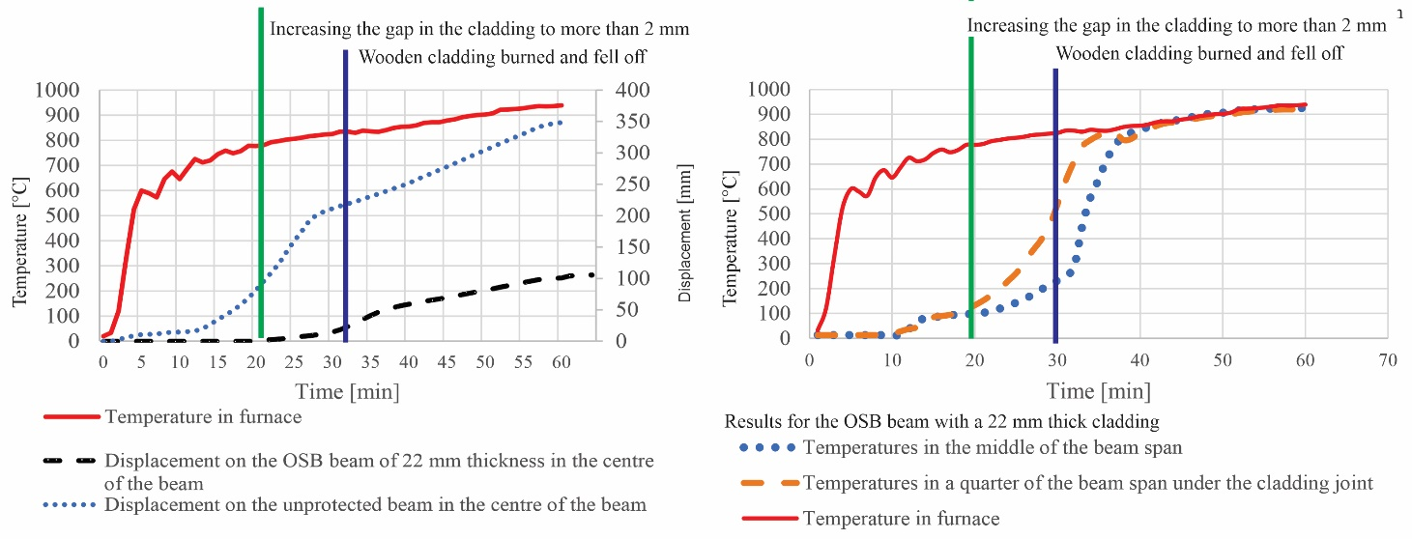
Introduction
Experiments
FE model
Summary
Displacement
Time [min] | Temperature in furnace [°C] | Unprotected beam (reference) [mm] | 1× OSB 22 mm protected beam [mm]
15 | 747 | 26 | 0
30 | 848 | 211 | 36
45 | 902 | 278 | 173
60 | 948 | 648 | 251

Slide 15
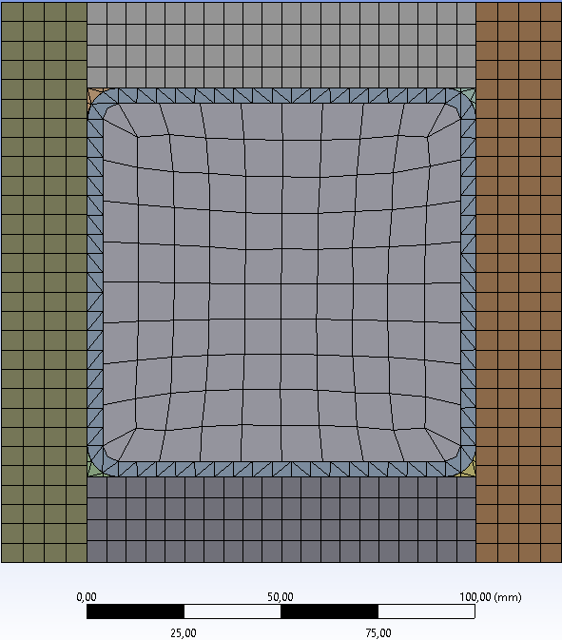
INSULATED
INSULATED
1 mm space in cladding
1 kN
MINERAL WOOL STEEL OSB CLADDING
AIR
FE Model
Introduction
Experiments
FEM model
Summary
ANSYS Mechanical
Sensitivity analysis
Tested on 2D cross-section
solved following already performed temperature analysis
MESH taken over for mechanical analysis
Calculation time considered
Temperature analysis = 15 days
Mechanical analysis = 3 days
for one calculation
AMD Ryzen 7 3750H with Radeon Vega Mobile Gfx 2.30 GHz, RAM 24 GB

Slide 16
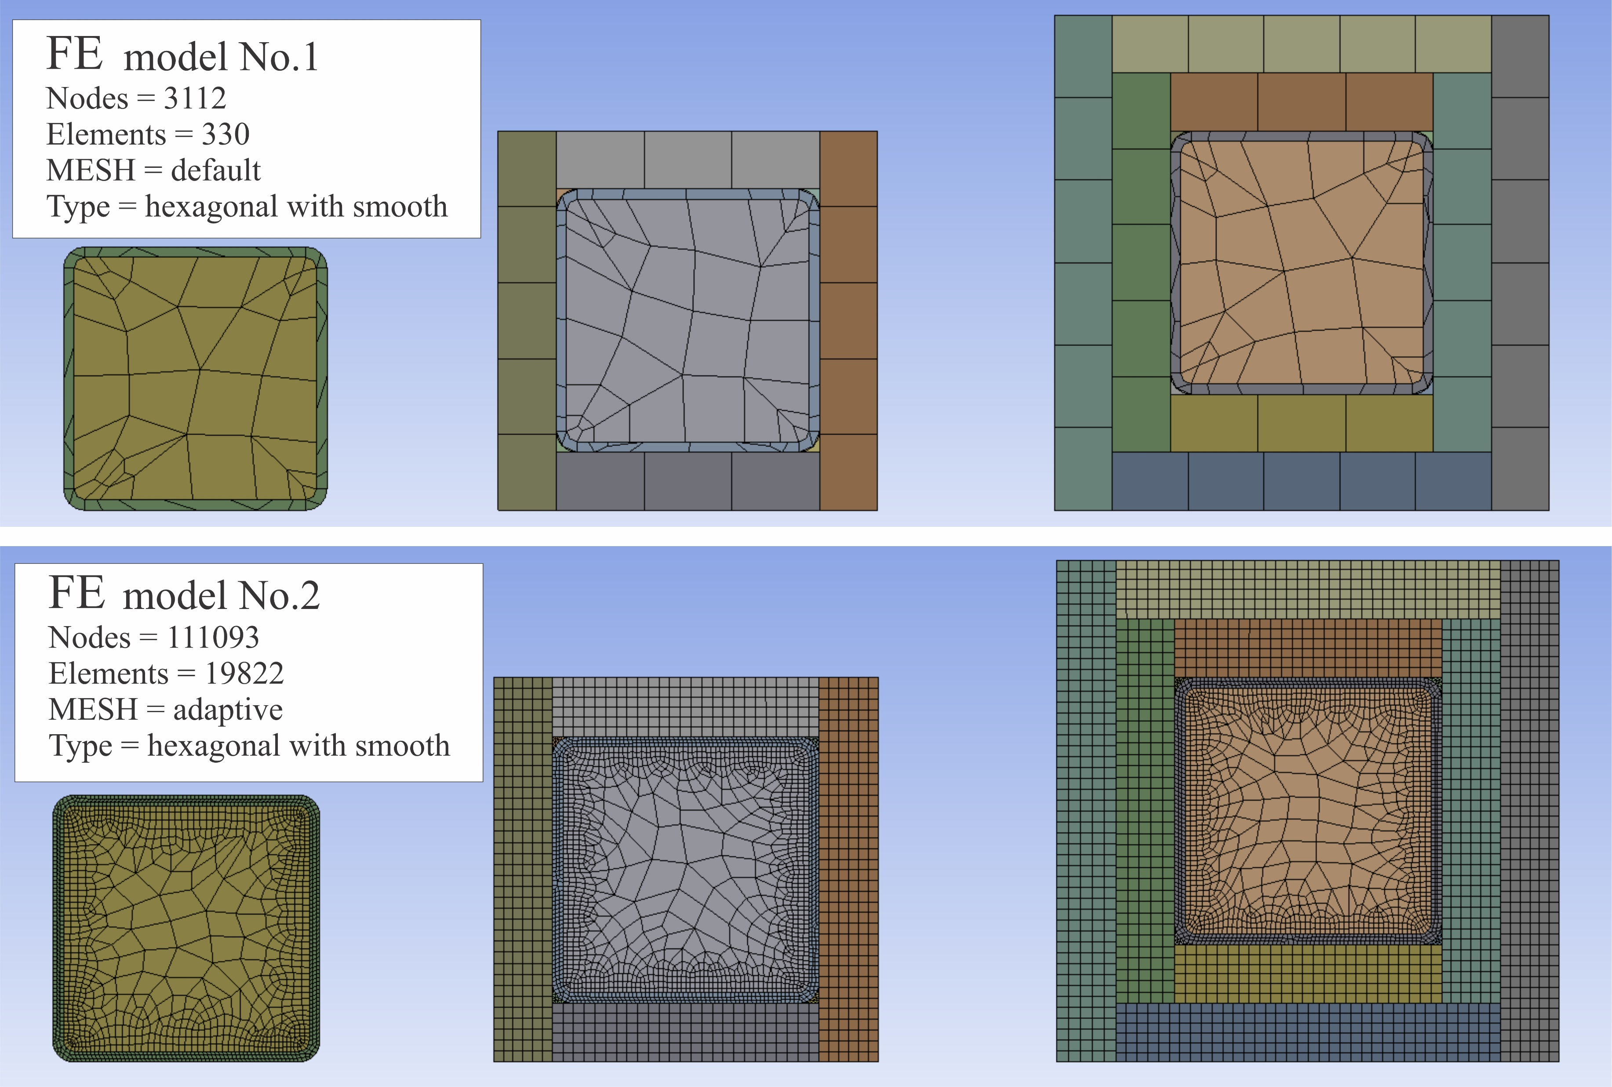

Slide 17
MESH | No.1 | No.2 | No.3 | No.4
Nodes | 42861 | 2269313 | 50772 | 41946889
Elements | 7410 | 489949 | 25130 | 30111563
Type of MESH | hexagonal | hexagonal | tetrahedrons | hybrid-tetrahedrons
Calculation time | 1 day | 17 days | 3 days | 23 days
AMD Ryzen 7 3750H with Radeon Vega Mobile Gfx 2.30 GHz, RAM 24 GB
FE Model
Introduction
Experiments
FE model
Summary
ANSYS Mechanical – Thermal analysis
Version 2021
Material properties EN 1993-1-2 EN 1995-1-2
implicit analysis
Temperatures applied to the surface from the experiment emissivity of OSB = 0.80 convection factor = 25 kW/m²
Developing of a model for cladding failure

Slide 18
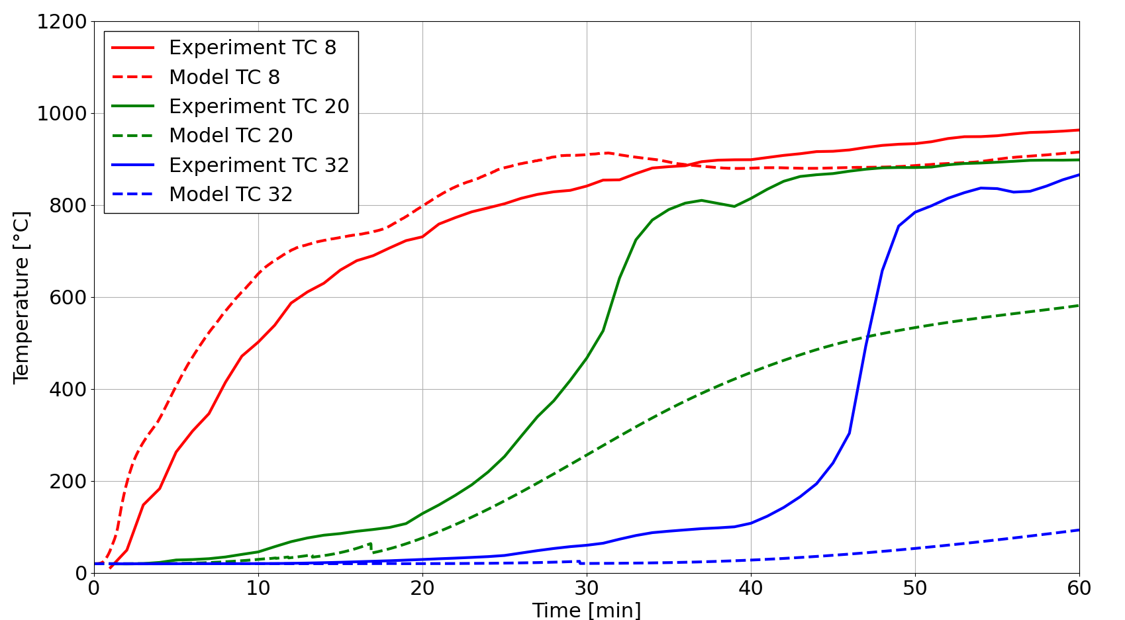
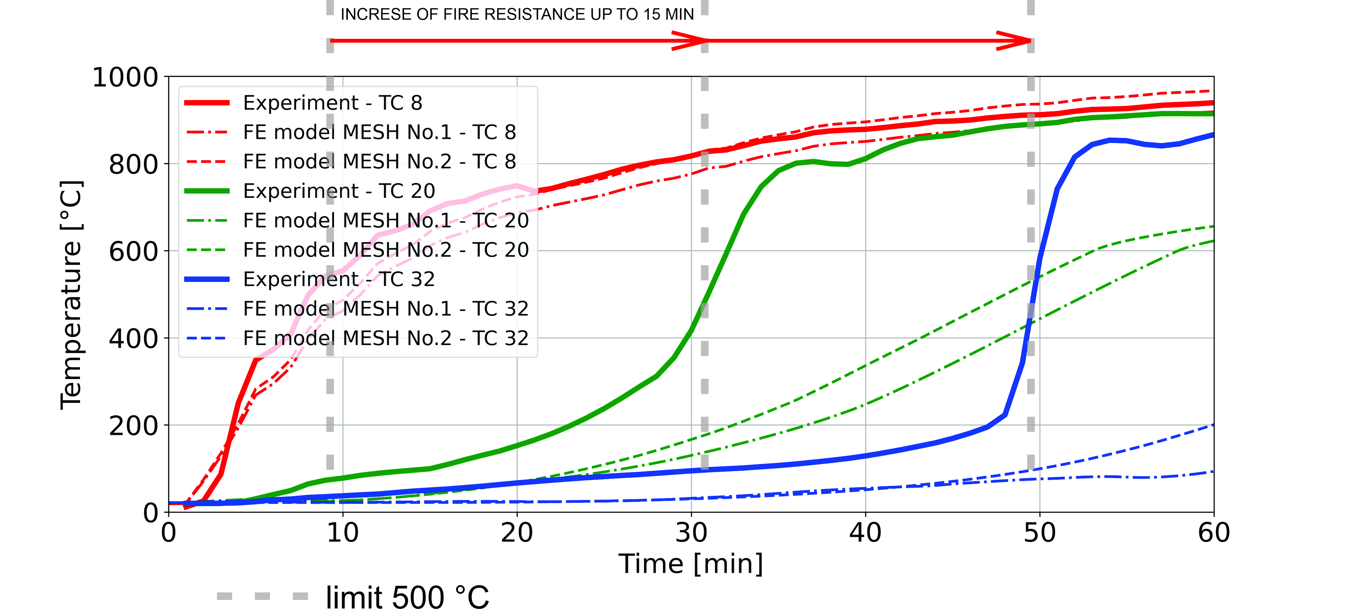
Vojta Šálek
CFD model
With pyrolysis
Jakub Šejna
FE model

Slide 19
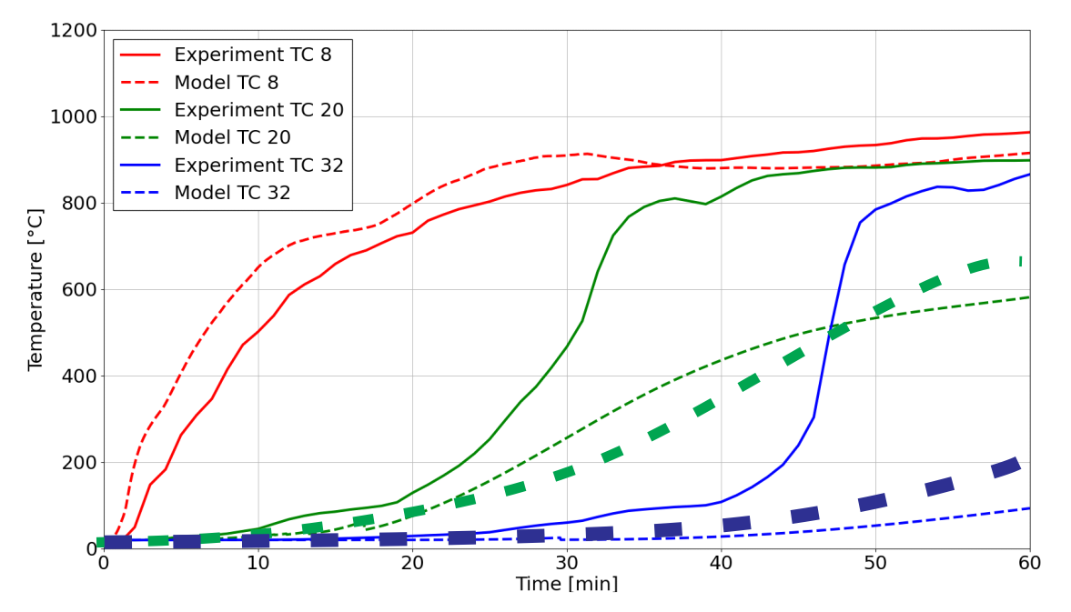
FE model
CFD model
FE model
CFD model

Slide 20
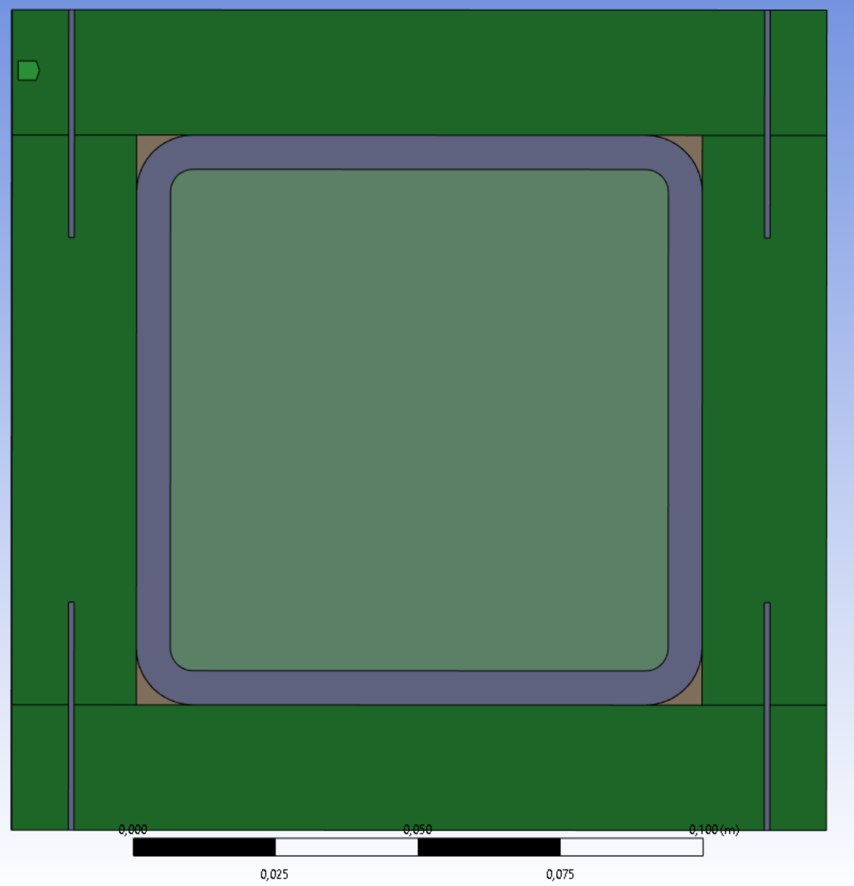
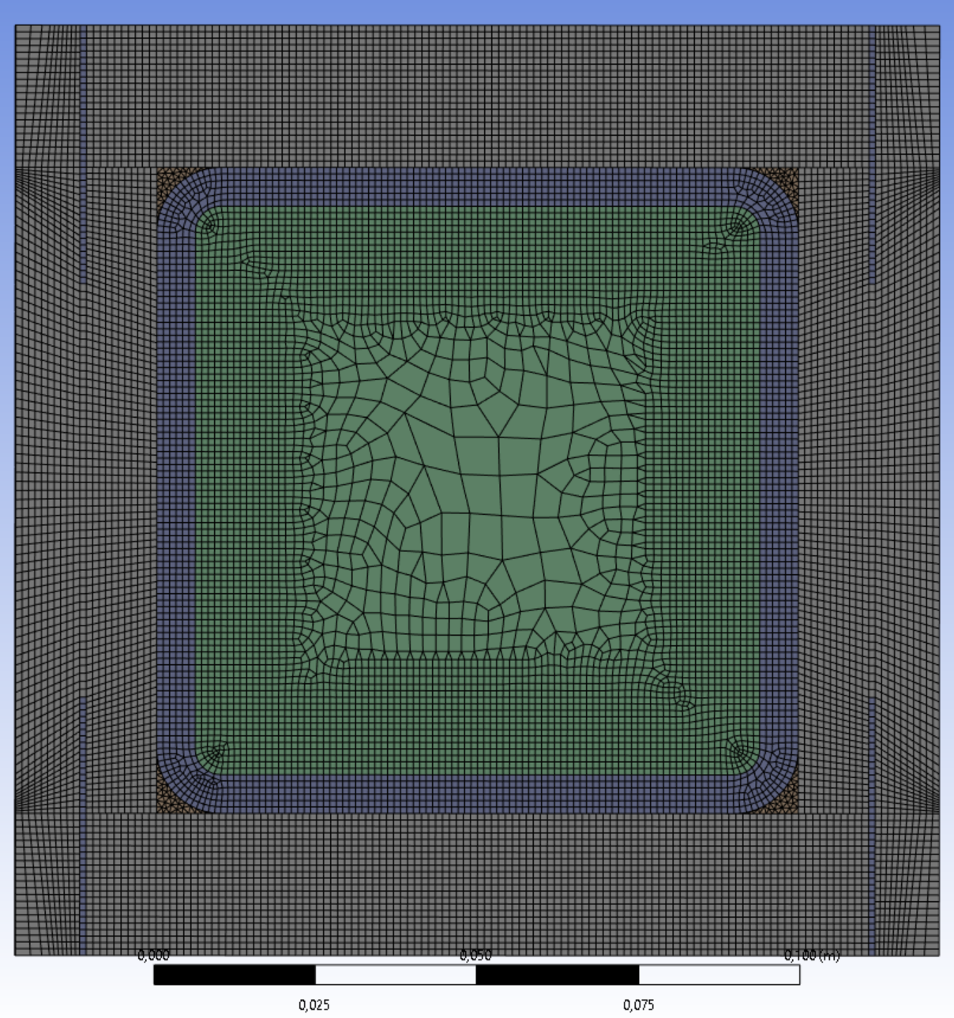
OLD
NEW
MESH | No.4
Nodes | 41 946 889
Elements | 30 111 563
Type of MESH | hybrid-tetrahedrons
Calculation time | 23 days
MESH | No.4
Nodes | 130 271 000
Elements | 93 720 140
Type of MESH | hybrid-tetrahedrons
Calculation time | 2 days
AMD Ryzen 7 3750H with Radeon Vega Mobile Gfx 2.30 GHz,
socket: 4; processor: 8;, RAM 24 GB
Intel(R) Xeon(R) Gold 6144 CPU @3.50 GHz; socket: 16; virtual processor: 32; RAM 20 GB

Slide 21
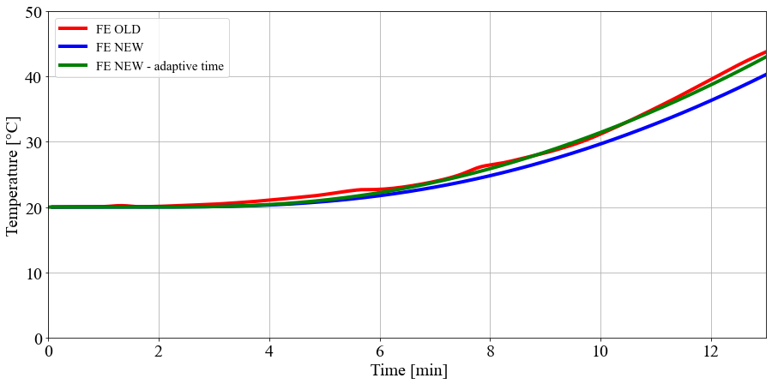
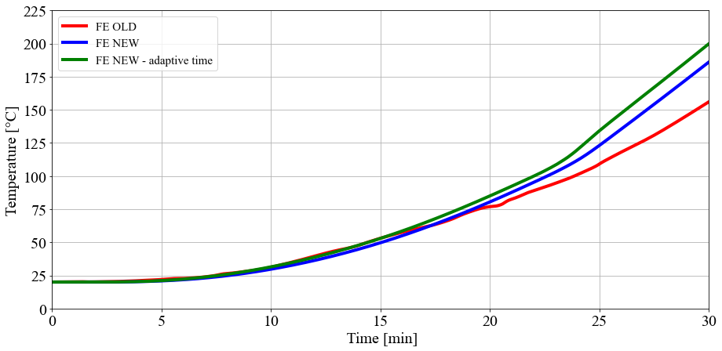
3 °C
Introduction
Experiments
FE model
Summary
45 °C

Slide 22
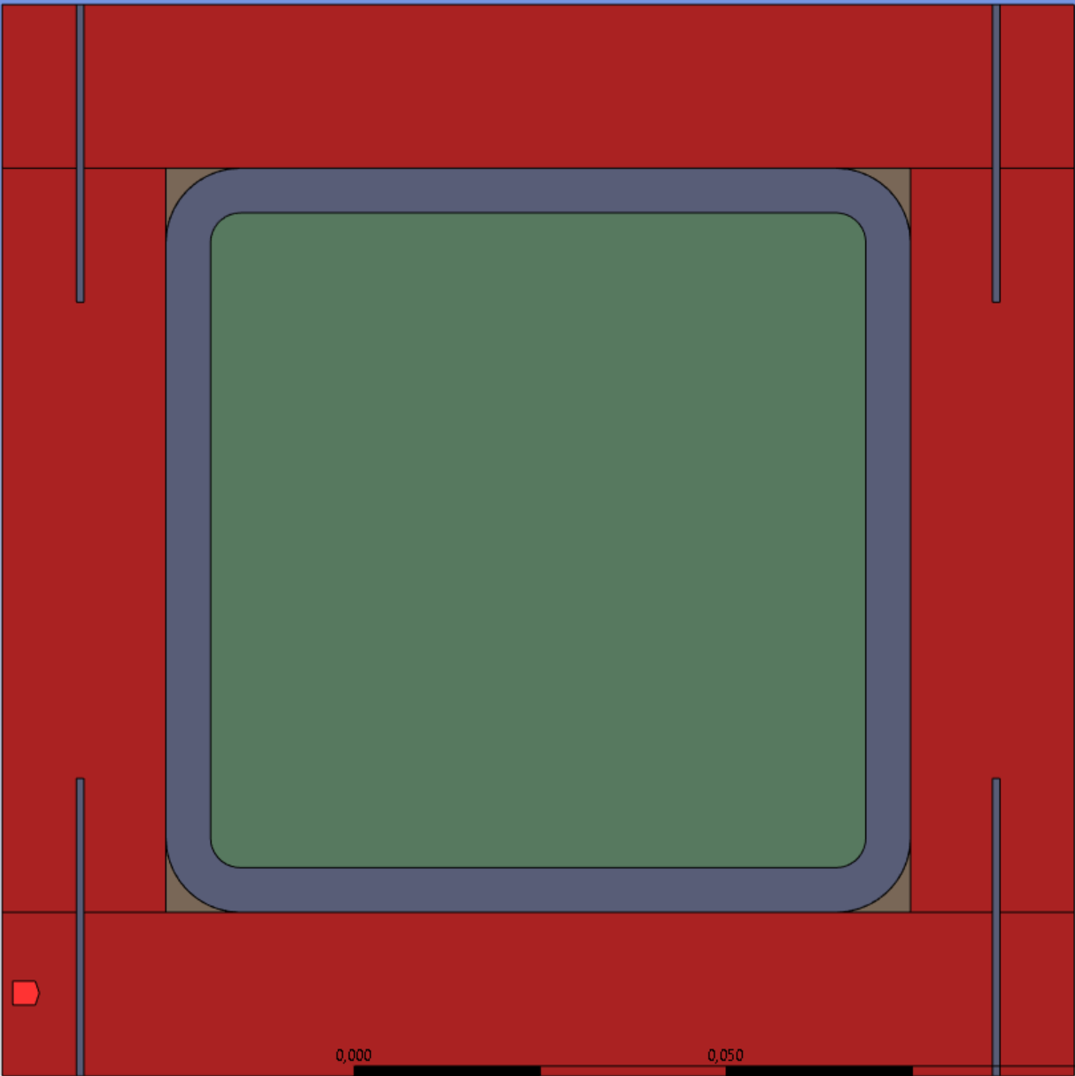
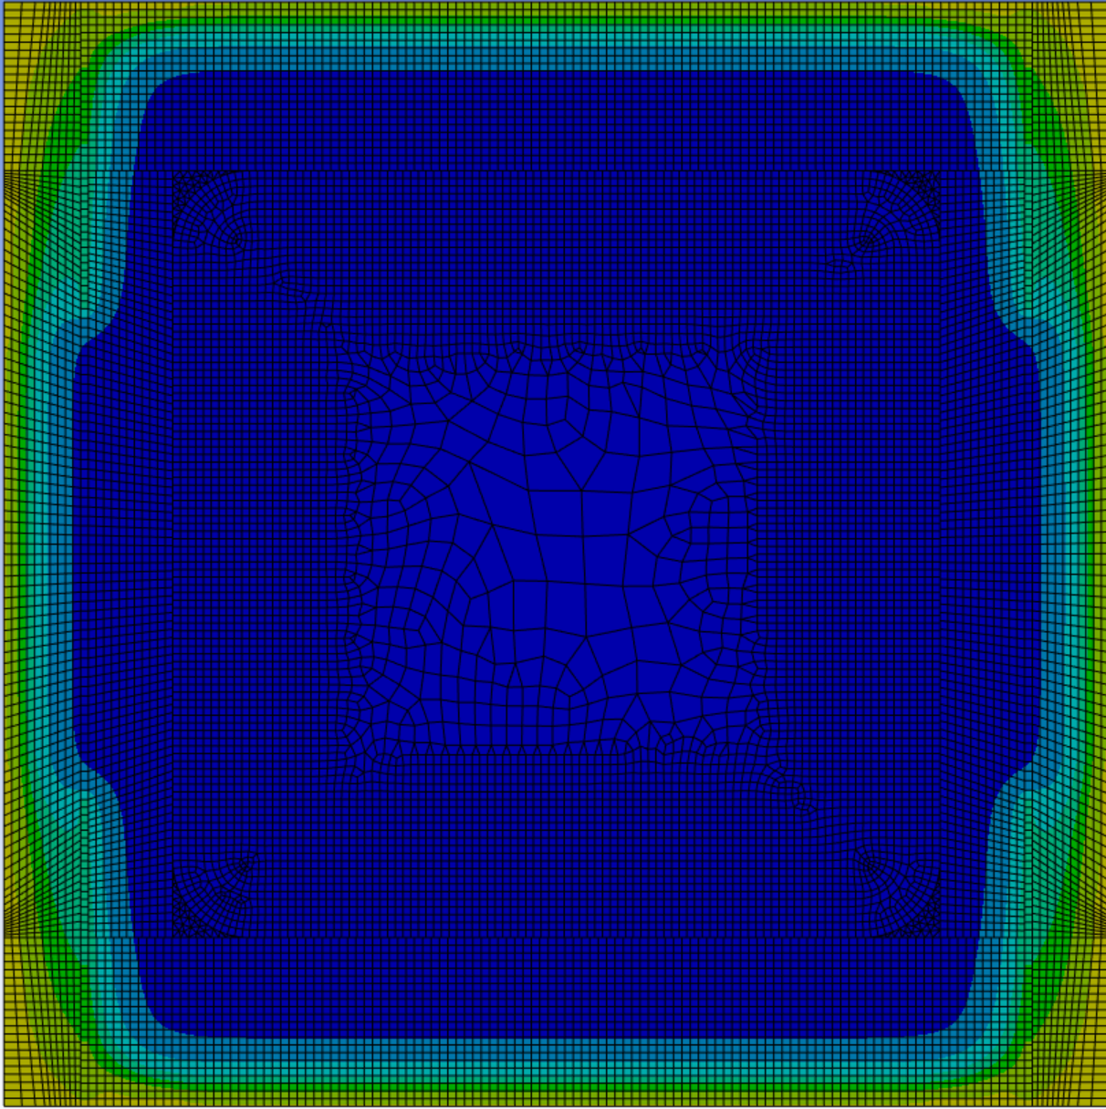
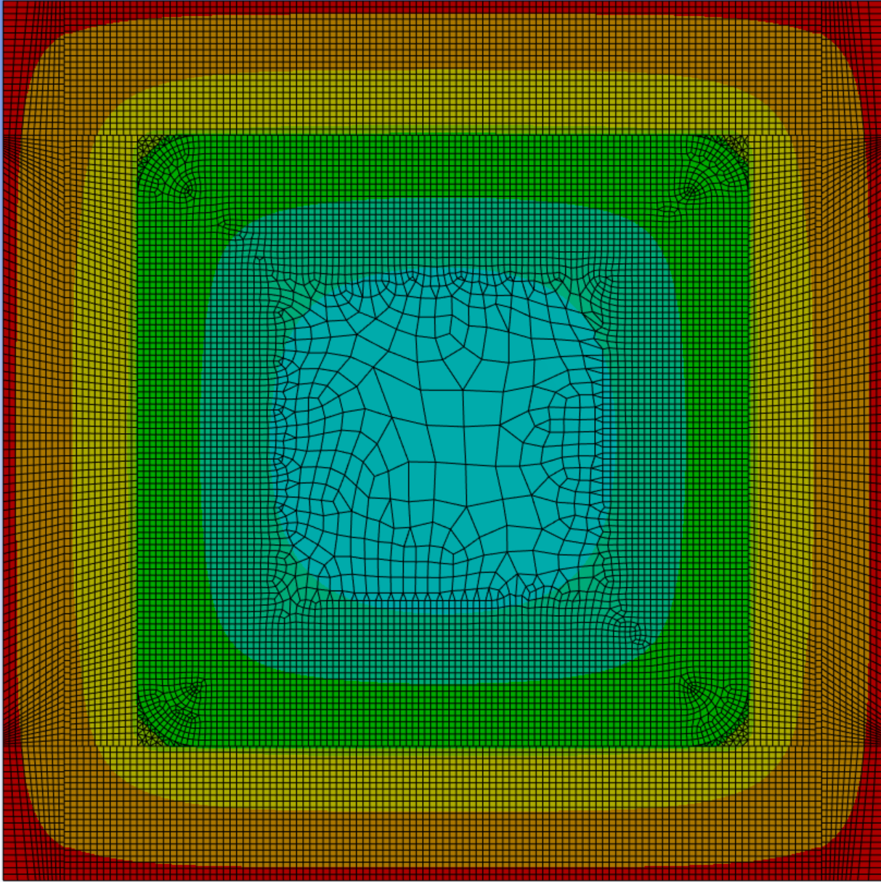
0 s
100 s
200 s
Introduction
Experiments
FE model
Summary
400 s
800 s
1600 s

Slide 23
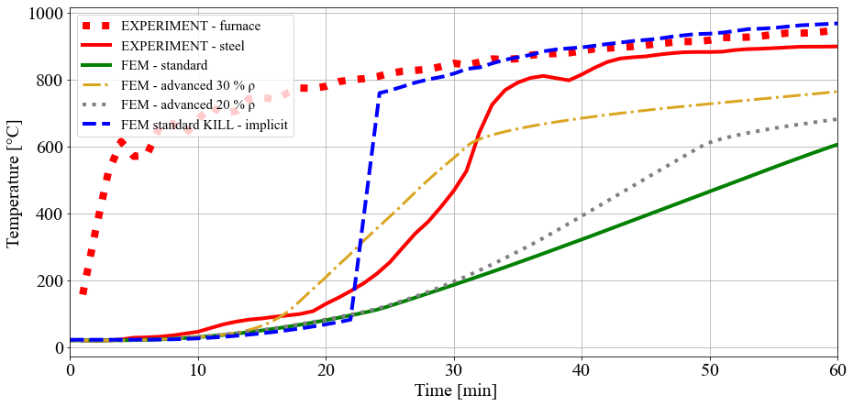
Introduction
Experiments
FE model
Summary
Developing a model with OSB cladding failure simulation
Combining knowledge from FE models and CFD models with pyrolysis

Slide 24
Summary
Despite the need to refine the development of the density of the OSB cladding for modelling (dependent on temperature)
Considering the failure time of the cladding, and the correct design of the OSB cladding thickness, the fire resistance of the steel beam can be increased by up to 30 minutes, for single-layer cladding – 22 mm.
Introduction
Experiments
FE model
Summary

Slide 25
THANK YOU FOR ATTENTION
JAKUB ŠEJNA

